Slide 1
WHY OWNERSHIP MATTERS
Andrew Longhurst

Slide 2
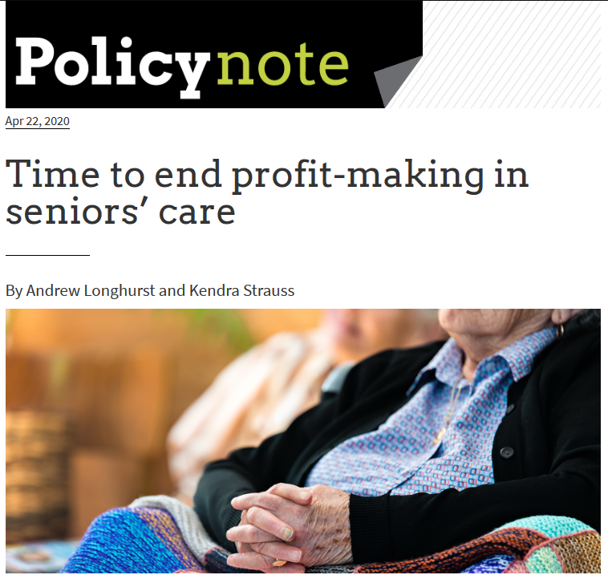
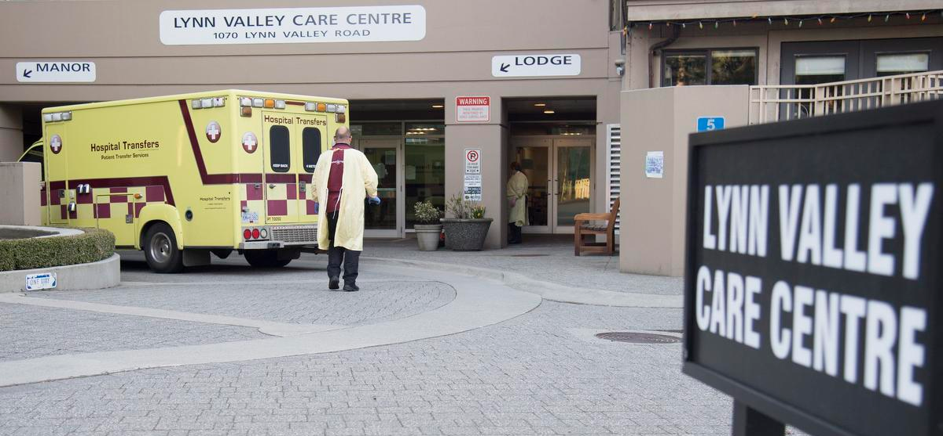
Why it’s time to end profit-making in seniors’ care
Andy Longhurst, MA
Research Associate, Canadian Centre for Policy Alternatives (BC)
Researcher & Policy Analyst, Health Sciences Association of BC
PhD student, Department of Geography, Simon Fraser University
May 28, 2020 | CCPA-BC Webinar

Slide 3
Ownership matters yet for-profit LTC displacing public and non-profit care
Source: A. Longhurst (2017), Privatization and Declining Access to BC Seniors’ Care, Canadian Centre for Policy Alternatives, BC Office.

Slide 4
Where does the (public) money go? Profit-making from public funding hardwired into the business model
Seniors Advocate reviewed financials for 174 contracted LTC homes in BC
Non-profit LTC homes spent 59% of revenues on direct care versus 49% in the for-profit sector
For-profit sector spends an avg. of 17% less per worked hour, and wages paid to care aide staff in the for-profit sector can be as much as 28% below the industry standard
Non-profits spent 9% of revenue on building expenses versus 20% in the for-profit sector: suggests inflated capital costs used to increase profits
For-profits generated 12x more profit than non-profits (surplus revenue)
While receiving, on average, same level of public funding:
Non-profits spent $10k or 24% more per year, per resident
For-profits failed to deliver 207k funded direct care hours
Non-profits provided 80k more direct care hours than funded to provide

Slide 5
Business model revealed: Profit-taking from direct care funding
Advocate: “We found the for-profit sector paid less per worked hour than the not-for-profit sector in each staffing classification.”
In 3/4 health authorities, contracted operators funded at level that assumes they pay staff at the unionized provincial standard
Only 4 of 99 for-profit facilities part of master collective agreement (2016)
Additional $10 million per month in provincial funding to top-up wages to the provincial unionized standard as result of single-site order
Increasing funding to operators who have underpaid their workers is not a cost-effective strategy now or beyond the current pandemic
Compel operators to pay provincial standard—without additional funding—and to re-join the public sector labour relations structure as required before early 2000s

Slide 6
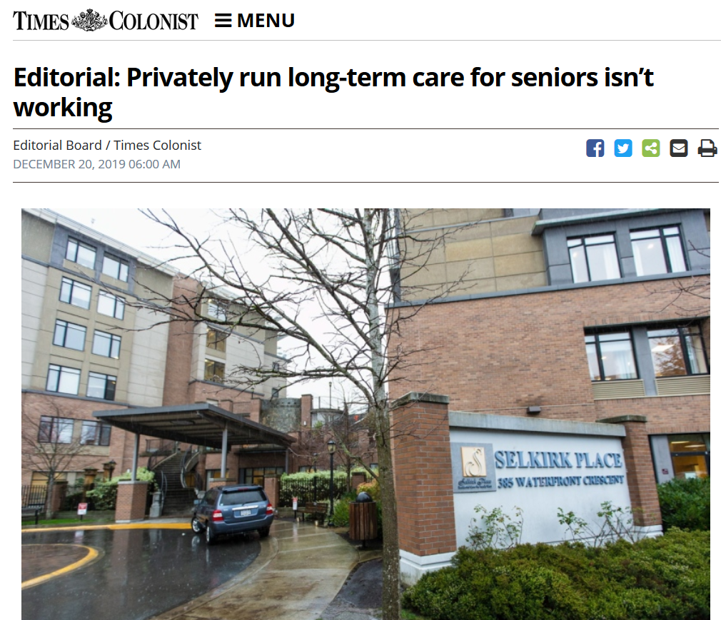
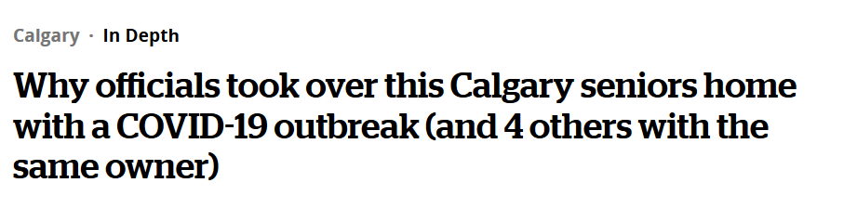
Investor-owned corporate chains: a growing concern
International evidence—and the unfolding tragedy in Canada—tells us that care chains tend to employ risky business practices.
Chains are typically bought and sold frequently using debt-leveraged buyouts, inflating asset sales prices and leaving the chains loaded with ever more debt until the cash flow—dependent on government funding—cannot meet the debt-servicing costs. This situation can result in financial crisis, bankruptcy, and chain failure.
The United Kingdom’s largest care chain—Southern Cross—collapsed in 2011 as a result of high-risk financial practices and successive flips of the real estate assets to different investors.
Southern Cross’s collapse created months of uncertainty for 31,000 residents and their families—as well as for 44,000 employees—until other buyers could be lined up.

Slide 7
Chains amassing real estate portfolios on the public dime
Embedded within the price of the contract is the private sector’s cost of debt servicing, or mortgage, or capital, however you want to describe it, but basically paying for the building. In fact, I am not sure that if you look at the totality of the money that it is cheaper for government to go this way because… generally there was a view [held by the private sector] that “I get my money back in 10 years. So, it cost me a million dollars to build it, over 10 years I am going to get a million dollars from the health authority in capital funding spread out, but at the end of 10 years I have my million dollars and I still have my building.” So we have allowed private sector interests, to be fair, a bunch of them are non-profits too… we have allowed them to build up wealth or equity on the taxpayers’ dime, whereas if we had done it as government our costs of borrowing will always be cheaper [than the rate obtained by the private sector] and we will still own the building…
Senior health system administrator, 2018

Slide 8
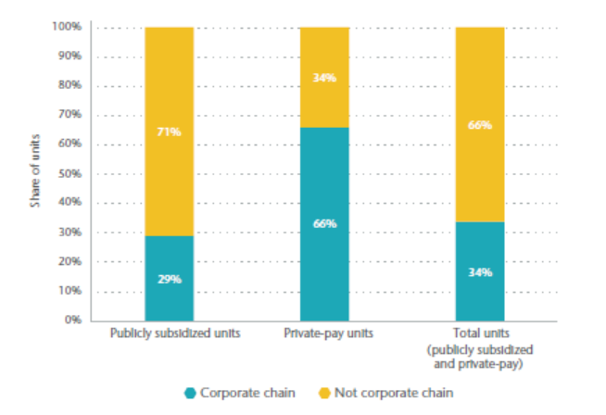
Time to end profit-making in seniors’ care
Chain presence is significant in BC and Canada
Business model built on extracting profit from public funding and erosion of working conditions
Not just about increased funding: where does the money go?
Guarantee quality and cost-effective delivery: address root of problem
Transition to 100% non-profit and public ownership
Develop seniors’ capital plan and start acquiring for-profit facilities mindful that we’ve indirectly paid for these assets
Share of assisted living and long-term care units controlled by corporate chains in British Columbia, 2016

